Slide 1

SOKOINE UNIVERSITY OF AGRICULTURE
School of Engineering and Technology | Department of Agricultural Engineering
AEN 214: INTRODUCTION TO ELECTRONICS — LECTURE 3
Semiconductor Diode & Circuits
Shockley Equation, Rectification, Power Smoothing, Clippers & Clampers
Course Instructor: Dr. Kadeghe Goodluck Fue, PhD, P.Eng (T)
Electronics & Precision Agriculture Laboratory | Academic Year 2025/2026 | Sokoine University of Agriculture
Sokoine University of Agriculture | School of Engineering & Technology | Department of Agricultural Engineering
Slide 1 of 26

Slide 2
AEN 214: INTRODUCTION TO ELECTRONICS
Lecture 3 Learning Outcomes & Practical Scope
• Model Diode I-V Characteristics: Master the Shockley equation, reverse saturation current I_S, and ideality factor eta.
• Derive Dynamic AC Resistance: Calculate small-signal resistance r_d = eta·V_T / I_DQ and understand junction capacitance.
• Evaluate Diode Approximations: Contrast ideal (0V), 2nd approximation (0.7V offset), and 3rd piecewise linear models.
• Analyze AC-to-DC Rectification: Design Half-Wave, Center-Tapped Full-Wave, and Full-Wave Bridge rectifier circuits.
• Design Power Smoothing Filters: Calculate DC output voltage V_DC, peak-to-peak ripple V_r, and ripple factor gamma.
• Synthesize Waveform Conditioning Circuits: Design positive/negative diode clippers (limiters) and clampers (DC restorers).
• Apply Diodes in AgriTech Power: Size solar charge controller rectifiers and battery reverse-polarity protection diodes.
Sokoine University of Agriculture | School of Engineering & Technology | Department of Agricultural Engineering
Slide 2 of 26

Slide 3
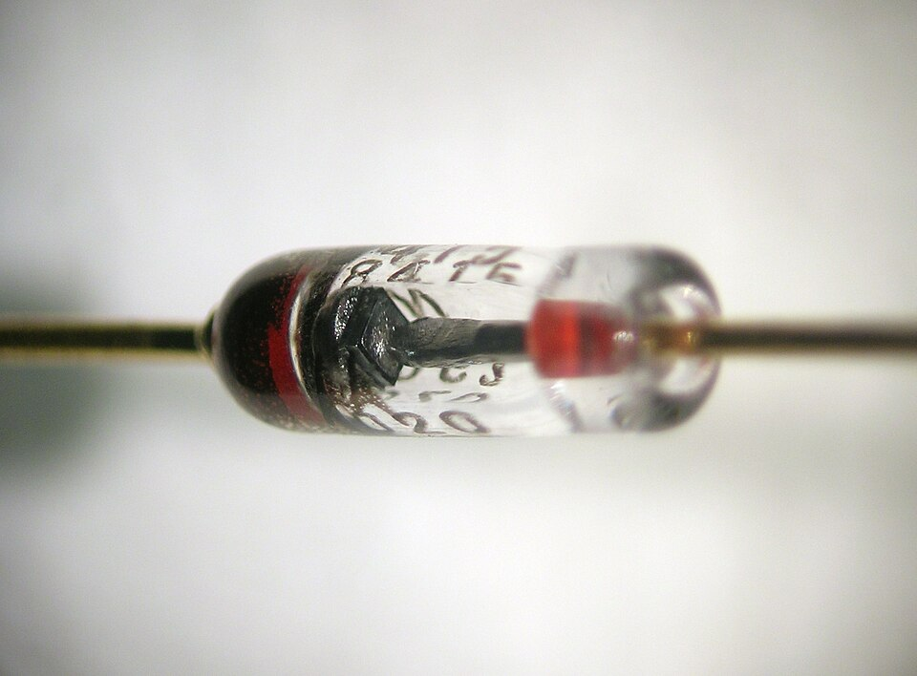
AEN 214: INTRODUCTION TO ELECTRONICS
Diode Power Circuits in Agricultural Electrification
• The AC-to-DC Bridge: Farm microcontrollers, sensor transmitters, and DC solenoid valves require pure DC power.
• Rural Grid Volatility: TANESCO rural supply lines experience severe voltage sags (down to 160V) and surges (> 270V).
• Solar Water Pumping: Photovoltaic panels generate fluctuating DC that requires diode steering, blocking, and rectification.
• Tractor Alternator Packs: 3-phase automotive alternators rely on six heavy-duty press-fit silicon diodes to charge 12V batteries.
• Battery Reverse-Polarity Destruction: Farm operators frequently connect tractor booster cables backwards; diodes provide fail-safe protection.
Sokoine University of Agriculture | School of Engineering & Technology | Department of Agricultural Engineering
Slide 3 of 26

Slide 4
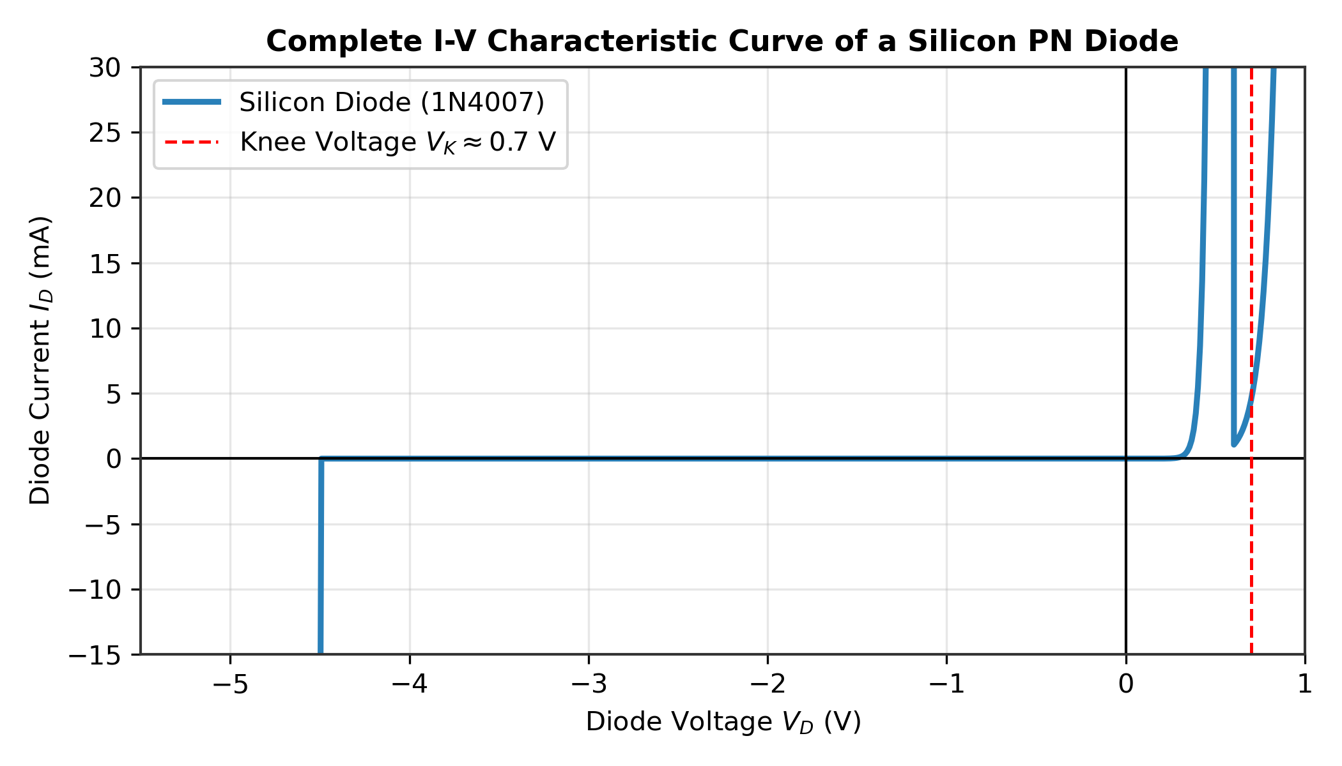
AEN 214: INTRODUCTION TO ELECTRONICS
The Shockley Diode Equation & Operating Regimes
• Governing Equation: I_D = I_S · [ exp( V_D / (eta · V_T) ) - 1 ], where I_S is reverse saturation current.
• Ideality Factor (eta): eta = 1.0 for pure diffusion current (Germanium, high-current Silicon); eta ≈ 2.0 at low currents in Silicon.
• Thermal Voltage: V_T = (k_B · T) / q ≈ 25.86 mV at 300 K (commonly taken as 26 mV in engineering calculations).
• Forward Bias Regime (V_D > 0.5 V): The exponential term dominates: I_D ≈ I_S · exp[ V_D / (eta · V_T) ].
• Reverse Bias Regime (V_D < -0.1 V): The exponential vanishes: I_D ≈ -I_S; current saturates to minuscule thermal leakage.
• Temperature Dependence: I_S doubles approximately every 5°C rise in temperature in silicon diodes.
Sokoine University of Agriculture | School of Engineering & Technology | Department of Agricultural Engineering
Slide 4 of 26

Slide 5
AEN 214: INTRODUCTION TO ELECTRONICS
Static vs Dynamic Diode Junction Resistance
• Static (DC) Resistance: R_D = V_DQ / I_DQ; The ratio of total DC voltage to total DC current at the operating Q-point.
• Dynamic (AC) Resistance: r_d = dV_D / dI_D |_(Q-point); The slope of the tangent line on the non-linear I-V curve.
• Mathematical Derivation: Since I_D ≈ I_S · exp[ V_D / (eta · V_T) ], differentiating gives: dI_D / dV_D = I_D / (eta · V_T).
• Reciprocal Slope Formula: r_d = (eta · V_T) / I_DQ ≈ 26 mV / I_DQ (for eta = 1 at room temperature).
• Practical Significance: At I_DQ = 1.0 mA, r_d = 26 Ohm; at I_DQ = 26 mA, r_d = 1.0 Ohm. Resistance drops as current rises!
Sokoine University of Agriculture | School of Engineering & Technology | Department of Agricultural Engineering
Slide 5 of 26

Slide 6
AEN 214: INTRODUCTION TO ELECTRONICS
Piecewise Linear Diode Approximations
• First Approximation (Ideal Diode): Perfect switch; 0V drop in forward bias (closed switch), 0A in reverse bias (open switch).
• Second Approximation (Constant Voltage Drop): Forward-biased diode modeled as a constant 0.7V DC source (0.3V for Germanium).
• Third Approximation (Complete Piecewise Model): Includes constant 0.7V offset in series with bulk dynamic resistance r_B: V_D = 0.7V + I_D · r_B.
• Reverse Recovery Time (t_rr): Time required for stored minority carriers to recombine before diode blocks reverse voltage.
• Junction Capacitances: Depletion capacitance C_dep dominates in reverse bias; Diffusion capacitance C_diff dominates in forward bias.
Sokoine University of Agriculture | School of Engineering & Technology | Department of Agricultural Engineering
Slide 6 of 26

Slide 7
AEN 214: INTRODUCTION TO ELECTRONICS
Half-Wave Rectifier Analysis & Metrics
• Circuit Operation: Single diode in series with AC secondary winding and load resistor R_L.
• Positive Half-Cycle (0 to pi): Diode forward-biased (ON); conducts current; v_out(t) = v_in(t) - V_knee.
• Negative Half-Cycle (pi to 2pi): Diode reverse-biased (OFF); blocks current; v_out(t) = 0V.
• Peak Output Voltage: V_m(out) = V_m - 0.7 V, where V_m = sqrt(2) · V_rms.
• DC Average Output Voltage: V_DC = V_m(out) / pi ≈ 0.318 · V_m(out).
• Peak Inverse Voltage (PIV): Maximum reverse voltage across diode: PIV = V_m.
• Rectification Efficiency: Maximum theoretical efficiency eta_max = 40.6%; leaves large ripple and poor transformer utilization.
Sokoine University of Agriculture | School of Engineering & Technology | Department of Agricultural Engineering
Slide 7 of 26

Slide 8
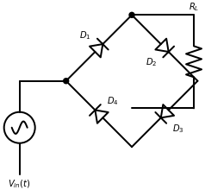
AEN 214: INTRODUCTION TO ELECTRONICS
Full-Wave Bridge Rectifier Architecture
• Four-Diode Bridge Topology: Conduction occurs on both AC half-cycles without requiring a bulky center-tapped transformer.
• Positive Half-Cycle: Diodes D1 and D2 conduct in series through load R_L; D3 and D4 are reverse-biased.
• Negative Half-Cycle: Diodes D3 and D4 conduct in series through load R_L in the SAME direction; D1 and D2 are reverse-biased.
• Peak Output Voltage: V_m(out) = V_m - 2 · V_knee = V_m - 1.4 V (due to two series conducting diodes).
• DC Average Output Voltage: V_DC = (2 · V_m(out)) / pi ≈ 0.636 · V_m(out) (double that of half-wave!).
• Peak Inverse Voltage: PIV = V_m(out) + 0.7 V ≈ V_m; Ripple frequency is 2 · f_in (100 Hz on 50 Hz TANESCO grid).
• Rectification Efficiency: Maximum theoretical efficiency eta_max = 81.2%.
Sokoine University of Agriculture | School of Engineering & Technology | Department of Agricultural Engineering
Slide 8 of 26

Slide 9
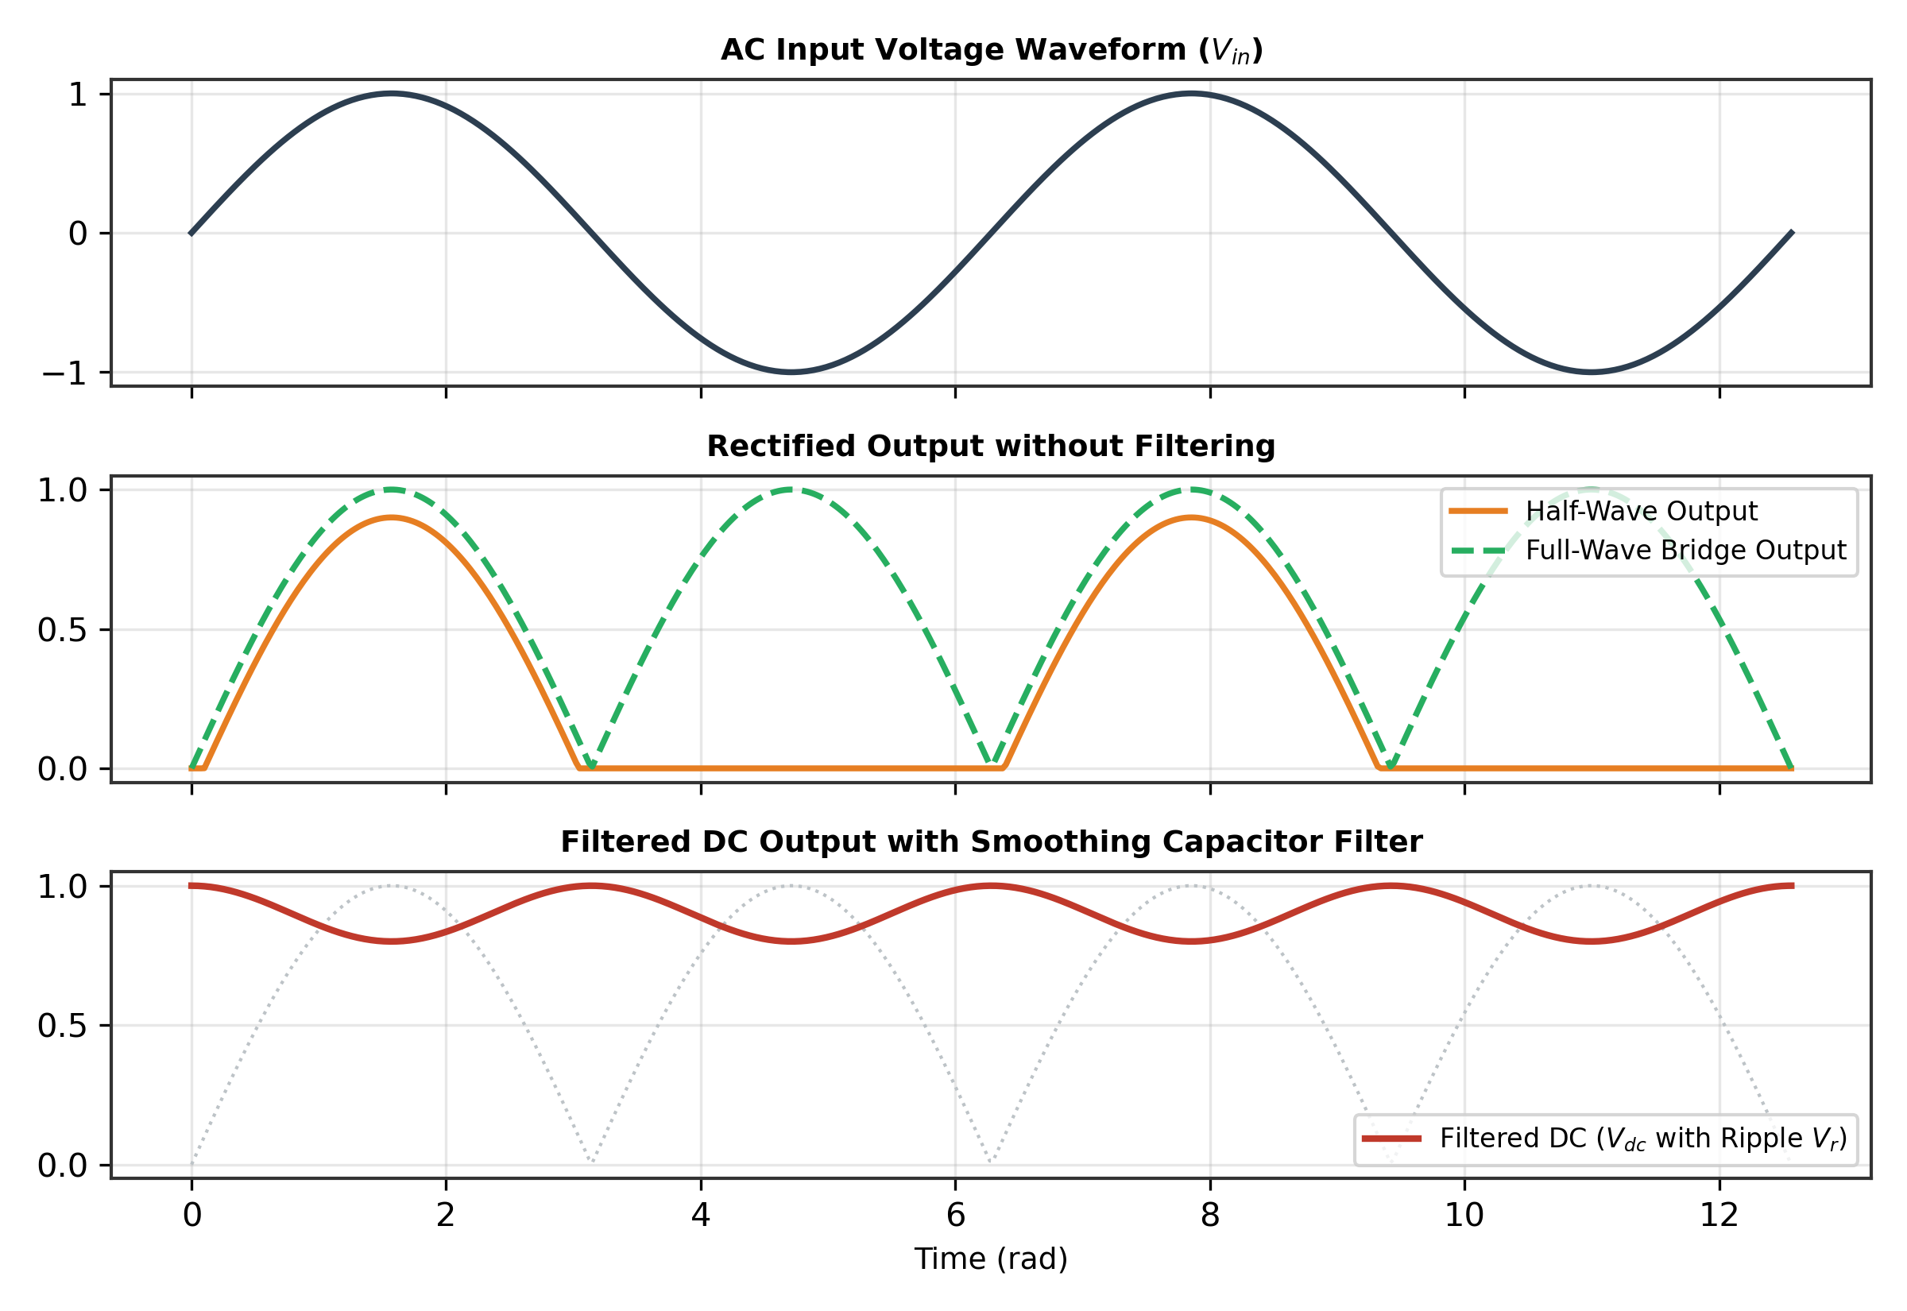
AEN 214: INTRODUCTION TO ELECTRONICS
Comparative Rectifier Output Waveforms
• Unfiltered Pulsating DC: Output contains large AC harmonic ripple voltages superimposed on the average DC level.
• Ripple Frequency: Half-wave ripple frequency = f_in (50 Hz); Full-wave ripple frequency = 2 · f_in (100 Hz).
• Transformer Utilization Factor (TUF): Bridge rectifier TUF = 0.812; Center-tapped TUF = 0.672; Half-wave TUF = 0.287.
• Diode Conduction Angle: Current flows for 180° in each branch of a full-wave rectifier compared to only 180° per cycle in half-wave.
• Thermal Dissipation: Power loss in bridge diodes: P_loss = 2 · V_D · I_DC_avg; requires aluminum heat sinking above 3 Amperes.
Sokoine University of Agriculture | School of Engineering & Technology | Department of Agricultural Engineering
Slide 9 of 26

Slide 10
AEN 214: INTRODUCTION TO ELECTRONICS
Capacitor Input Smoothing Filters & Ripple Factor
• Smoothing Action: A large electrolytic capacitor C is placed in parallel with load R_L.
• Charging Phase: Diode conducts briefly at waveform peaks, rapidly charging C to peak voltage V_peak.
• Discharging Phase: When input drops below capacitor voltage, diodes cut off; C discharges slowly through R_L with time constant tau = R_L · C.
• Peak-to-Peak Ripple Voltage: V_r(p-p) ≈ I_DC / (2 · f · C) = V_DC / (2 · f · R_L · C) (for full-wave rectifier).
• DC Output Voltage with Filter: V_DC ≈ V_peak - 0.5 · V_r(p-p).
• Ripple Factor (gamma): gamma = V_r,rms / V_DC ≈ 1 / [ 4 · sqrt(3) · f · R_L · C ]; Lower gamma indicates purer DC.
• Diode Surge Current (I_surge): During initial turn-on, uncharged capacitor pulls intense inrush current; requires surge-rated diodes.
Sokoine University of Agriculture | School of Engineering & Technology | Department of Agricultural Engineering
Slide 10 of 26

Slide 11
AEN 214: INTRODUCTION TO ELECTRONICS
Worked Engineering Example 1: Dynamic Resistance of Temperature Sensor Diode
PROBLEM SPECIFICATION & AGRICULTURAL CONTEXT:
A 1N4148 silicon small-signal diode is used as a linear temperature sensor probe in a Morogoro poultry egg incubator. Operating under forward bias at room temperature (T = 300 K, eta = 1.0, V_T = 26 mV), its quiescent DC current is set to I_DQ = 2.50 mA. When forward voltage shifts by Delta V = 10 mV, calculate: (a) Dynamic AC junction resistance r_d, (b) Corresponding change in diode current Delta I, (c) Recalculate r_d if bias current is increased to 20.0 mA.
STEP-BY-STEP MATHEMATICAL SOLUTION & VERIFICATION:
1. Dynamic Resistance Formula: r_d = (eta · V_T) / I_DQ.
2. Calculate at 2.50 mA: r_d = (1.0 · 26 mV) / 2.50 mA = 0.026 V / 0.0025 A = 10.40 Ohm.
3. Small-Signal Current Change: Delta I ≈ Delta V / r_d = 10 mV / 10.40 Ohm = 0.010 V / 10.40 Ohm = 0.9615 mA (961.5 microA).
4. Recalculate at 20.0 mA: r_d = 26 mV / 20.0 mA = 0.026 V / 0.020 A = 1.30 Ohm.
5. Engineering Insight: Increasing the DC operating current by 8 times reduces the dynamic junction resistance by 8 times, providing a much stiffer signal source for sensor interfacing.
Sokoine University of Agriculture | School of Engineering & Technology | Department of Agricultural Engineering
Slide 11 of 26

Slide 12
AEN 214: INTRODUCTION TO ELECTRONICS
Worked Engineering Example 2: Full-Wave Bridge Rectifier & Filter for Drip PLC
PROBLEM SPECIFICATION & AGRICULTURAL CONTEXT:
Design a full-wave bridge rectifier power supply for an automated drip irrigation PLC at Kilombero Sugar Estate. The step-down transformer secondary delivers V_rms = 18.0 V at f = 50 Hz. The PLC load draws a continuous DC current I_DC = 1.50 A. Silicon diodes have forward drop V_D = 0.70 V. Calculate: (a) Peak output voltage V_peak, (b) Required filter capacitance C to limit peak-to-peak ripple to V_r(p-p) <= 1.20 V, (c) Resulting DC output voltage V_DC, (d) Minimum diode PIV rating.
STEP-BY-STEP MATHEMATICAL SOLUTION & VERIFICATION:
1. Peak AC Secondary Voltage: V_m = sqrt(2) · V_rms = 1.4142 · 18.0 V = 25.46 V.
2. Peak Rectified Output Voltage: Bridge drops two diodes: V_peak = V_m - 2·V_D = 25.46 V - 1.40 V = 24.06 V.
3. Sizing Smoothing Filter: V_r(p-p) = I_DC / (2 · f · C) -> C = I_DC / (2 · f · V_r(p-p)).
Substitute: C = 1.50 A / (2 · 50 Hz · 1.20 V) = 1.50 / 120 = 0.0125 F = 12,500 microFarad (select standard 15,000 microF / 35V).
4. Average DC Output Voltage: V_DC = V_peak - 0.5 · V_r(p-p) = 24.06 V - 0.5(1.20 V) = 24.06 V - 0.60 V = 23.46 V.
5. Diode PIV Requirement: PIV = V_m - V_D = 25.46 V - 0.70 V = 24.76 V. (With 2x farm safety factor, specify 1N5402 with PIV >= 100V).
Sokoine University of Agriculture | School of Engineering & Technology | Department of Agricultural Engineering
Slide 12 of 26

Slide 13
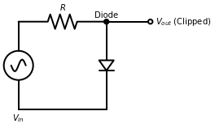
AEN 214: INTRODUCTION TO ELECTRONICS
Diode Clipper (Limiter) Circuit Topologies
• Circuit Function: Removes (clips) portions of an input signal above or below a specified reference level without distorting the remainder.
• Positive Clipper: Diode conducts when input exceeds reference V_ref + 0.7V, shunting excess voltage to ground or reference rail.
• Negative Clipper: Diode placed in reverse polarity; clips the negative excursion below -V_ref - 0.7V.
• Biased Clippers: A DC bias battery in series with the diode sets the clipping threshold to any desired positive or negative potential.
• Combination (Dual) Clipper: Two anti-parallel diodes clamp input signal between +0.7V and -0.7V; protects microcontroller ADC pins.
Sokoine University of Agriculture | School of Engineering & Technology | Department of Agricultural Engineering
Slide 13 of 26

Slide 14
AEN 214: INTRODUCTION TO ELECTRONICS
Diode Clamper (DC Restorer) Circuits
• Circuit Function: Shifts the entire AC waveform to a different DC reference level without altering the peak-to-peak waveshape.
• Circuit Architecture: Requires a series capacitor C, a shunt diode D, and a parallel discharge resistor R_L.
• Positive Clamper: Diode cathode grounded; diode conducts on negative peaks, charging capacitor to V_peak; output shifted positively above 0V.
• Negative Clamper: Diode anode grounded; capacitor charges to positive peak; entire waveform shifted negatively below 0V.
• Clamping Time Constant Rule: The RC discharge time constant must be much larger than the signal period: R_L · C >= 10 · T_signal.
Sokoine University of Agriculture | School of Engineering & Technology | Department of Agricultural Engineering
Slide 14 of 26

Slide 15
AEN 214: INTRODUCTION TO ELECTRONICS
Worked Engineering Example 3: Diode Input Overvoltage Limiter for Tractor ECU
PROBLEM SPECIFICATION & AGRICULTURAL CONTEXT:
An analog soil conductivity sensor on an autonomous tractor outputs an analog signal v_in that fluctuates between -4.0 V and +9.0 V. The tractor microcontroller ADC input accepts strictly 0.0 V to +5.0 V. Design a biased dual-diode clipper using 1N4148 silicon diodes (V_D = 0.70 V) and a series current-limiting resistor R = 2.2 kOhm. Determine: (a) The required bias voltages V_bias,high and V_bias,low, (b) Output voltage range, (c) Maximum diode power dissipation during +9.0 V overvoltage.
STEP-BY-STEP MATHEMATICAL SOLUTION & VERIFICATION:
1. Top Limiter Design (Clip at +5.0 V): We require output clamped to +5.0 V. Since diode drops 0.70 V: V_out,max = V_bias,high + V_D -> 5.0 V = V_bias,high + 0.70 V -> V_bias,high = 4.30 V (or connect diode anode to +5.0V rail -> clips at 5.0 + 0.7 = 5.7V).
Using precise bias: V_bias,high = 4.30 V clamps output at exactly +5.0 V.
2. Bottom Limiter Design (Clip at 0.0 V): We require output clamped to 0.0 V. Since bottom diode drops 0.70 V: V_out,min = V_bias,low - V_D -> 0.0 V = V_bias,low - 0.70 V -> V_bias,low = +0.70 V (or ground anode -> clips at -0.7V).
Using precise bias: V_bias,low = +0.70 V clamps output at exactly 0.0 V.
3. Peak Overvoltage Current: At v_in = +9.0 V, output is clamped to +5.0 V. Voltage across series resistor: V_R = 9.0 V - 5.0 V = 4.0 V.
Diode Forward Current: I_D = V_R / R = 4.0 V / 2,200 Ohm = 1.818 mA.
4. Diode Power Dissipation: P_diode = V_D · I_D = 0.70 V · 1.818 mA = 1.27 mW (well within 1N4148 rating of 500 mW!).
Sokoine University of Agriculture | School of Engineering & Technology | Department of Agricultural Engineering
Slide 15 of 26

Slide 16
AEN 214: INTRODUCTION TO ELECTRONICS
Commercial Diode Specifications & Selection Guide
• Maximum Average Forward Current (I_F(AV)): Rated continuous DC forward current (e.g. 1N4007 = 1.0A; 1N5408 = 3.0A; 6A10 = 6.0A).
• Peak Inverse Voltage (PIV / V_RRM): Maximum repetitive peak reverse voltage before avalanche breakdown (1N4007 = 1,000V).
• Forward Voltage Drop (V_F): Typical forward drop at rated current (0.7V to 1.1V for silicon; 0.3V to 0.45V for Schottky).
• Peak Forward Surge Current (I_FSM): Maximum allowable single half-sine inrush current (1N4007 = 30A for 8.3 ms).
• Thermal Resistance (theta_JA): Junction-to-ambient thermal resistance; determines temperature rise Delta T = P_diss · theta_JA.
Sokoine University of Agriculture | School of Engineering & Technology | Department of Agricultural Engineering
Slide 16 of 26

Slide 17
AEN 214: INTRODUCTION TO ELECTRONICS
DC Battery Reverse-Polarity Protection Topologies
• Series Diode Protection: Place rectifier diode in series with positive DC input; blocks reverse current completely.
• Forward Drop Drawback: Series diode dissipates power: P_loss = V_D · I_load; at 5A load, drops 0.7V and generates 3.5W heat.
• Shunt Diode with Fuse (Crowbar): Place reverse-biased diode across supply rails behind a fast-acting fuse.
• Crowbar Action: Correct polarity -> diode is OFF; Reversed polarity -> diode conducts heavily, blowing the fuse within 10 ms.
• MOSFET Reverse Protection: P-channel MOSFET provides reverse protection with ultra-low voltage drop (R_DS(on) < 10 mOhm).
Sokoine University of Agriculture | School of Engineering & Technology | Department of Agricultural Engineering
Slide 17 of 26

Slide 18
AEN 214: INTRODUCTION TO ELECTRONICS
Small-Signal AC Superposition & Diode Load Line
• Quiescent Operating Point (Q-point): The DC voltage V_DQ and current I_DQ established by DC bias supplies and resistors.
• DC Load Line Equation: I_D = (V_CC - V_D) / R_L; Straight line connecting (V_CC, 0) and (0, V_CC / R_L) on I-V plane.
• Q-point Intersection: Intersection of DC load line and non-linear diode characteristic curve determines exact operating point.
• Small-Signal AC Model: When small AC signal v_ac is superimposed, diode behaves as linear dynamic resistance r_d.
• Total Instantaneous Output: v_out(t) = V_DQ + v_ac(t) · [ R_L / (R_L + r_d) ]; Verified by superposition principle.
Sokoine University of Agriculture | School of Engineering & Technology | Department of Agricultural Engineering
Slide 18 of 26

Slide 19
AEN 214: INTRODUCTION TO ELECTRONICS
Hardening Diode Circuits for Rural Agriculture
• Thermal Heatsinking: High-current bridge rectifiers (> 10A) must be bolted to finned aluminum extrusions with thermal paste.
• Dust and Mud Accumulation: Heavy red laterite dust forms insulating blankets over heatsinks, causing thermal runaway; use IP66 sealed housings.
• Lightning Induced Spikes: Rural TANESCO overhead lines pick up electrostatic charges; parallel 1.5KE400A TVS diodes protect bridge inputs.
• Electrolytic Filter Derating: Specify 105°C rated capacitors rather than consumer 85°C types to guarantee 10-year lifespan under tropical sun.
• Vibration Resistance: Heavy bridge rectifiers on tractor chassis must be mechanically staked with RTV silicone adhesive.
Sokoine University of Agriculture | School of Engineering & Technology | Department of Agricultural Engineering
Slide 19 of 26

Slide 20
AEN 214: INTRODUCTION TO ELECTRONICS
Tanzanian Field Case Study 1: Solar Milking Machine Battery Reverse Clamping
FIELD LOCATION & PROBLEM IDENTIFICATION
• Geographic Location: Msolwa Ujamaa Dairy Cooperative, Kilombero, Tanzania
A community dairy cooperative powered their automated milking pulsator and milk chilling vat from a 24V solar battery bank. During night battery swaps, attendants accidentally reversed the heavy battery booster cables twice in one month, blowing the main inverter motherboard and spoiling 450 liters of fresh milk.
SUA ENGINEERING SOLUTION & AGRONOMIC IMPACT
SUA agricultural engineers retrofitted the DC input stage with a heavy-duty 50A, 1,200V stud-mount silicon rectifier diode (1N1188) in anti-parallel behind a 40A fast-blow automotive ceramic fuse. An adjacent warning buzzer was wired to sound instantly if reverse polarity is detected.
Measurable Performance Metrics:
✔ Successfully protected inverter electronics during two subsequent accidental cable reversals.
✔ Saved over 4,500 USD in potential motherboard repair costs and milk wastage.
✔ Zero operating power loss during normal dairy milking machine running.
Sokoine University of Agriculture | School of Engineering & Technology | Department of Agricultural Engineering
Slide 20 of 26

Slide 21
AEN 214: INTRODUCTION TO ELECTRONICS
Tanzanian Field Case Study 2: Bridge Rectifier Failure in Grain Aeration Blowers
FIELD LOCATION & PROBLEM IDENTIFICATION
• Geographic Location: National Food Reserve Agency (NFRA) Silo Depot, Morogoro, Tanzania
Commercial grain aeration blowers operating at a 20,000-tonne maize storage depot experienced frequent DC power supply burnouts during the rainy season. DC control boards lost power, shutting down ventilation fans and causing grain caking and moisture hot spots in silo bins 3 and 7.
SUA ENGINEERING SOLUTION & AGRONOMIC IMPACT
Forensic analysis of the blown 4-diode bridges revealed that high-voltage inductive switching spikes from adjacent 75 kW blower motors were generating peak reverse surges exceeding 850V, exceeding the 400V PIV rating of the factory-installed bridges. Engineers replaced the bridges with 1,000V, 25A metal-cased KBPC2510 modules paired with 0.1 microF snubber capacitors.
Measurable Performance Metrics:
✔ Achieved 100% power supply reliability through two consecutive wet storage campaigns.
✔ Grain moisture remained safely uniform at 13.2% without a single metric ton lost to spoilage.
✔ Snubber capacitors absorbed motor inductive spikes, reducing transient noise by 88%.
Sokoine University of Agriculture | School of Engineering & Technology | Department of Agricultural Engineering
Slide 21 of 26

Slide 22
AEN 214: INTRODUCTION TO ELECTRONICS
Laboratory Bench Protocol: Full-Wave Bridge Rectifier & Filter Characterization
PRACTICAL LAB LEARNING OUTCOMES & BENCH REQUIREMENTS:
• Assemble a full-wave bridge rectifier circuit on breadboard using four 1N4007 diodes.
• Measure input AC and unfiltered pulsating DC waveforms on digital storage oscilloscope.
• Add electrolytic filter capacitors (100 microF, 470 microF, 1,000 microF) and quantify ripple voltage reduction.
• Implement a positive diode clipper and verify clipping threshold against DC bias supply.
STEP-BY-STEP PROTOTYPING & DIAGNOSTIC PROCEDURE:
Step 1: Connect 12V AC secondary transformer winding to bridge input on breadboard; connect 1 kOhm load resistor.
Step 2: Connect DSO Ch 1 across transformer secondary; connect DSO Ch 2 across load resistor. Record V_peak and V_DC.
Step 3: Insert 470 microFarad capacitor across load. Measure peak-to-peak ripple V_r(p-p) and calculate empirical ripple factor.
Step 4: Increase load current by placing 220 Ohm resistor in parallel; observe ripple voltage increase on DSO screen.
Step 5: Assemble biased clipper circuit with 3V DC bench source; inject 10V p-p sine wave; verify flat clipping at 3.7V.
Sokoine University of Agriculture | School of Engineering & Technology | Department of Agricultural Engineering
Slide 22 of 26

Slide 23
AEN 214: INTRODUCTION TO ELECTRONICS
Diagnostic Troubleshooting of Diode Circuits
• Open-Circuit Diode: DMM diode test reads 'OL' (overload) in BOTH forward and reverse directions; in bridge, causes half-wave output.
• Shorted Diode: DMM reads near 0.000 V and beeps in BOTH directions; in bridge, shorts the transformer secondary and blows fuse.
• Excessive Ripple Voltage: Dried-out electrolytic filter capacitor loses capacitance; DC voltage drops and AC hum increases drastically.
• Thermal Overheating: Diode exceeds 150°C junction temperature; silicon thermal leakage increases until thermal runaway occurs.
• Reverse Leakage Surge: High operating temperatures in engine bays cause I_S to surge, triggering false alarms in high-impedance sensors.
Sokoine University of Agriculture | School of Engineering & Technology | Department of Agricultural Engineering
Slide 23 of 26

Slide 24
AEN 214: INTRODUCTION TO ELECTRONICS
Lecture 3 Self-Assessment & Upcoming Topics
SELF-ASSESSMENT & PROBLEM-SOLVING EXERCISES:
Q: Write the Shockley diode equation and define all parameters including thermal voltage V_T and ideality factor eta.
Q: Derive the small-signal dynamic resistance r_d of a diode and calculate its value at I_DQ = 5.0 mA at 300 K.
Q: Compare Half-Wave, Center-Tapped Full-Wave, and Bridge rectifiers in terms of PIV, average DC output, and efficiency.
Q: Explain why a capacitor input filter causes intense surge currents through rectifier diodes during initial power turn-on.
Q: Draw the circuit diagram of a dual-diode clipper that limits an analog sensor signal between -0.7 V and +3.3 V.
NEXT LECTURE PREVIEW & REQUIRED PREPARATION:
Lecture 4 will explore Special Purpose Diodes: Zener shunt regulators, LEDs for PAR grow lighting, and Schottky solar bypass diodes.
Sokoine University of Agriculture | School of Engineering & Technology | Department of Agricultural Engineering
Slide 24 of 26

Slide 25
AEN 214: INTRODUCTION TO ELECTRONICS
Lecture 3 Synthesis: Key Takeaways & Formula Sheet
CORE CONCEPTUAL TAKEAWAYS
✔ The diode conducts exponentially in forward bias (0.7V for Si) and blocks current in reverse bias.
✔ Small-signal dynamic resistance is inversely proportional to DC bias current: r_d ≈ 26 mV / I_DQ.
✔ Full-wave bridge rectifiers provide 81.2% maximum theoretical efficiency with PIV = V_m.
✔ Smoothing capacitors reduce ripple to V_r(p-p) ≈ I_DC / (2 · f · C); larger capacitance yields purer DC.
✔ Clippers limit voltage excursions for ADC pin protection; clampers restore or shift DC reference levels.
CRITICAL ENGINEERING FORMULAS
★ Shockley Equation: I_D = I_S · [ exp( V_D / (eta · V_T) ) - 1 ]
★ Dynamic Resistance: r_d = (eta · V_T) / I_DQ ≈ 26 mV / I_DQ
★ Half-Wave DC: V_DC = V_peak / pi; PIV = V_m
★ Full-Wave Bridge DC: V_DC = 2·V_peak / pi; V_peak = V_m - 1.4V
★ Filter Ripple Voltage: V_r(p-p) = I_DC / (2 · f · C)
★ Ripple Factor: gamma = 1 / [ 4 · sqrt(3) · f · R_L · C ]
★ Diode Power Loss: P = V_D · I_avg
Sokoine University of Agriculture | School of Engineering & Technology | Department of Agricultural Engineering
Slide 25 of 26

Slide 26
AEN 214: INTRODUCTION TO ELECTRONICS
Prescribed References & Practical Laboratory Preparation
• Boylestad, R. L., & Nashelsky, L. (2018). Electronic Devices and Circuit Theory (11th ed.). Pearson Education.
• Sedra, A. S., & Smith, K. C. (2020). Microelectronic Circuits (8th ed.). Oxford University Press.
• Floyd, T. L. (2017). Electronic Devices: Conventional Current Version (10th ed.). Pearson.
• Laboratory Preparation: Review oscilloscope AC coupling vs DC coupling modes before Lab Session 3.
• Field Assignment: Complete Assignment 1, Questions 9 to 12 on diode rectification and filtering.
Sokoine University of Agriculture | School of Engineering & Technology | Department of Agricultural Engineering
Slide 26 of 26

